Slide 1
SPAM MAIL PREDICTION
MACHINE LEARNING PROJECT.
PREDICTING WHETHER A MESSAGE IS SPAM OR HAM
USING NATURAL LANGUAGE PROCESSING(NLP) AND MACHINE LEARNING.
DATASET CONTAINS 5,572 MESSAGES
BY ATFA KHAN

Slide 2
INTRODUCTION
Spam messages are unwanted or suspicious messages.
Spam detection helps identify such messages automatically.
Machine Learning can learn patterns from previous messages.
This project predicts whether a message is Spam or Ham.

Slide 3

DATASET DESCRIPTION
Dataset contains 5,572 messages.
It has 2 columns: Category and Message.
Ham represents a normal message.
Spam represents a spam message.

Slide 4
DATA PREPROCESSING
Loaded the SMS messages dataset.
Converted ham and spam into numerical values.
Ham=0
Spam=1
Prepared the text data for Macine Learning.

Slide 5
METHODOLOGY
Dataset > Data Preparation>TF-IDF>Train/Test Split> Model Training>Prediction>Evaluation
Messages were divided into training and testing data.
TF-IDF was used to convert text into numerical features.
Machine Learning models were trained using the processed data.

Slide 6

TF-IDF
TF-IDF stands for Term Frequecy-Inverse Document Frequency.
It converts text messages into numerical values.
Important words receive higher importance.
This allows the Machine Learning model to work with text data.

Slide 7
MACHINE LEARNING MODELS
Logistic Regression was used for classification.
Naive Bayers was used for comparison.
Both models were trained using TF-IDF features.
Their performance was evaluated using test data.

Slide 8
MODEL RESULTS
Logistic Regression accuracy : 97.49%
Naïve Bayes accuracy: 96.50%
Logistic Regression performed better on our test dataset.
Logistic Regression was selected as the final model based on test accuracy.

Slide 9
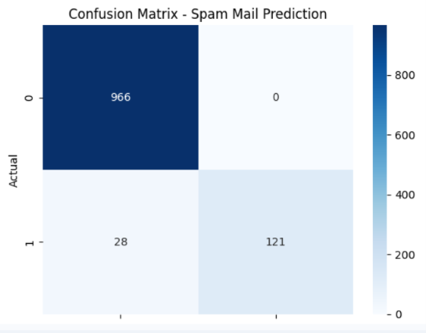
CONFUSION MATRIX
The confusion matrix shows correct and incorrect predictions.
It compares actual classes with predicted classes.
It shows how well the model identifies spam and normal messages.
The confusion matrix was generated using logistic Regression predictions.

Slide 10
CONCLUSION
Machine Learning can be used for spam message detection.
TF-IDF helped convert text into useful numerical features.
Logistic Regression achieved 97.49% accuracy on our test dataset.
Naive Bayes 96.50% accuracy.
The project demonstrates how NLP and Macine Learning can be combined for spam detection.

